Slide 1

Data Management Planning 20th January 2016
Jonathan Rans
Digital Curation Centre
This work is licensed under the Creative Commons Attribution 2.5 UK: Scotland License.

Slide 2
What is a data management plan?
A brief plan written at the start of your project to define:
how will your data be created?
how will it be documented?
who will access it?
where will it be stored?
who will back it up?
whether (and how) will it be shared & preserved?
DMPs are often submitted as part of grant applications, but are useful whenever researchers are creating data.

Slide 3
Why develop a DMP?
They can help you to:
Make informed decisions that anticipate & avoid problems
Avoid duplication, data loss and security breaches
Provide guidelines for everyone working on the project
To comply with funder requirements…

Slide 4
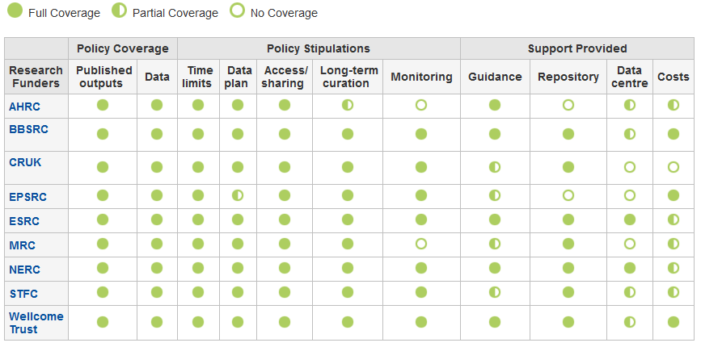
Which UK funders require a DMP?
www.dcc.ac.uk/resources/policy-and-legal/ overview-funders-data-policies

Slide 5



Some other funders that require DMPs

Slide 6
Common themes in DMPs
Description of data to be collected / created
(i.e. content, type, format, volume...)
Standards / methodologies for data collection & management
Ethics and Intellectual Property
(highlight any restrictions on data sharing e.g. embargoes, confidentiality)
Plans for data sharing and access
(i.e. how, when, to whom)
Strategy for long-term preservation

Slide 7
Tips on writing DMPs
Keep it simple, short and specific
Seek advice - consult and collaborate
Base plans on available skills and support
Make sure implementation is feasible
Justify any resources or restrictions needed
www.youtube.com/watch?v=7OJtiA53-Fk

Slide 8
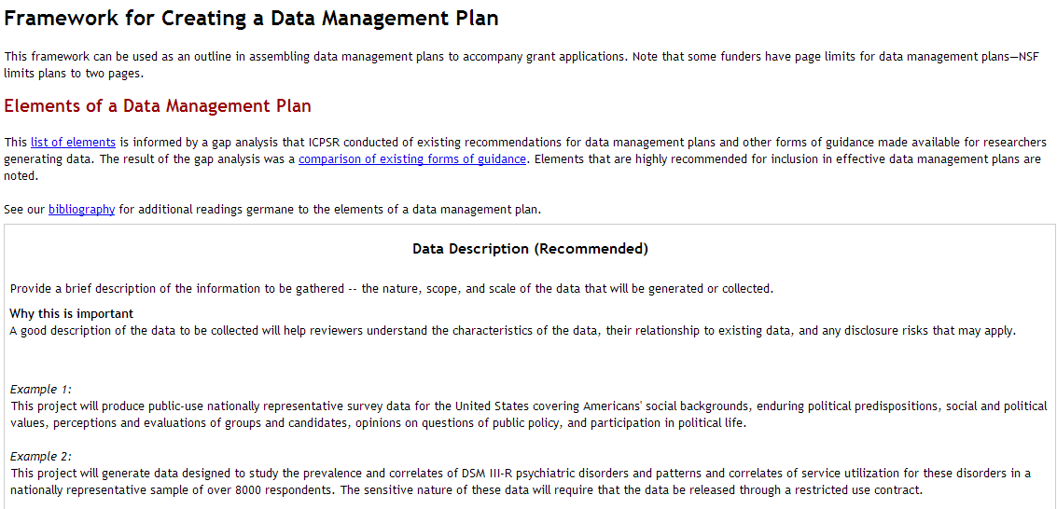
A useful framework to get started
Think about why the questions are being asked – why is it useful to consider that topic?
Look at examples to help you understand what to write
www.icpsr.umich.edu/icpsrweb/content/datamanagement/dmp/framework.html
Notes:
I recommend this ICPSR resource (Interuniversity Consortium for Political and Social Research)
It explains the importance of different questions as a pointer to how to answer
Examples are given. This is the most frequent request we get at DCC - examples help researchers think of what to write for their context

Slide 9

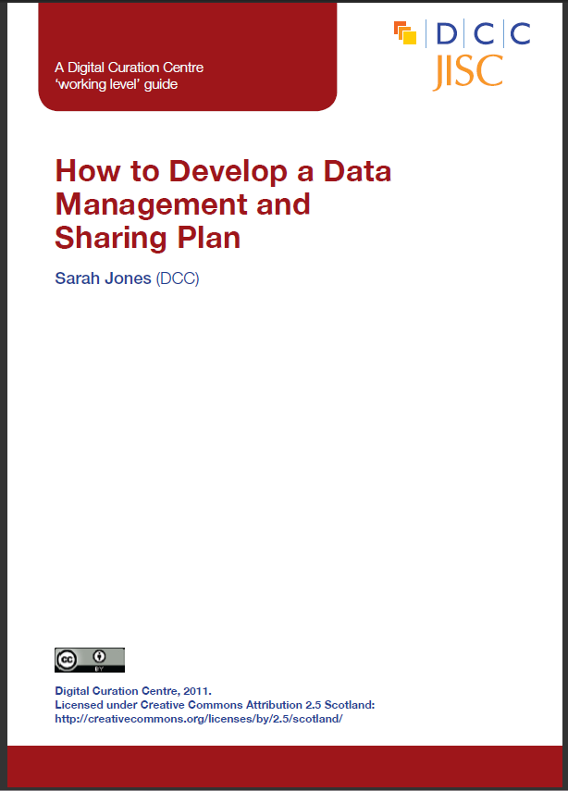
Help from the DCC
A web-based tool to help researchers write data management plans
https://dmponline.dcc.ac.uk
www.dcc.ac.uk/resources/how-guides/develop-data-plan
Notes:
The DCC has produced a How to guide on writing DMPs and developed a tool to help

Slide 10
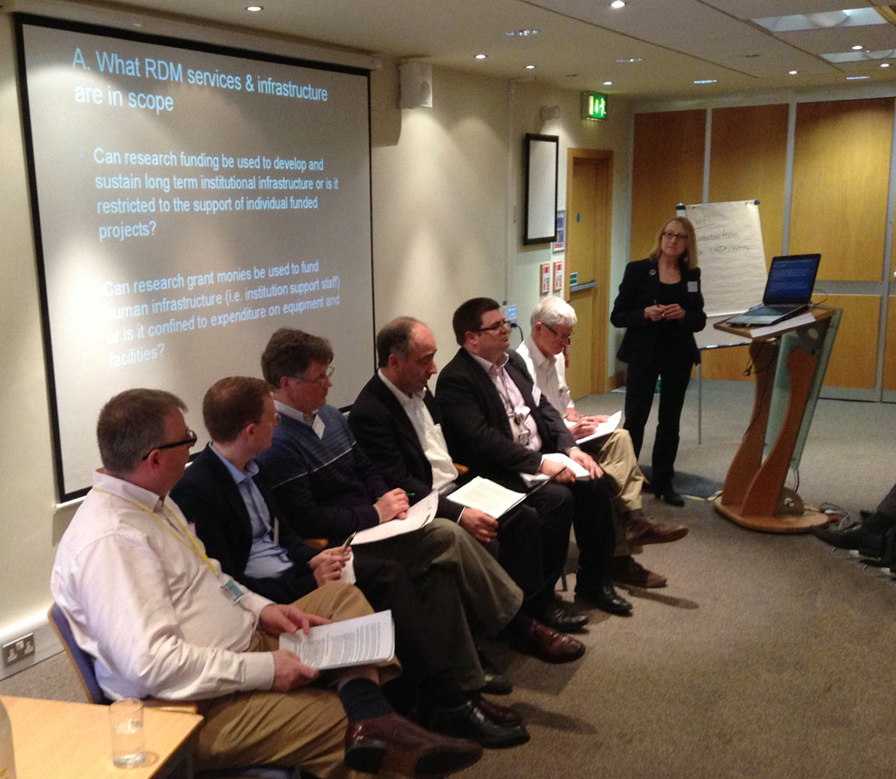
Who should pay for RDM?
Funding Research Data Management
"A conversation with the funders”
The DCC held a special event on this topic in the UK, but there’s still a long way to go
www.dcc.ac.uk/events/research-data-management-forum-rdmf/rdmf-special-event-funding-research-data-management

Slide 11
What to charge and how?
Direct costs
In-project costs that must be incurred before the end of the grant
Potentially hardware, staff, expenses, costs of preparing data for deposit...
Could include charges levied by repositories (pay once store forever)
May also include costs ordinarily recovered indirectly (e.g. storage) if the requirement is exceptional and exceeds the norm
Indirect costs
The general cost of providing RDM services and infrastructure
Designated data services should be used if provided
Outsourcing to a third-party is also an option
Remember to make a clear justification for any costs

Slide 12
Key messages
All costs are eligible, but:
Direct costs must be incurred before a grant ends
Nothing can be double funded (recovered indirectly and as a direct)
Researchers are expected to use designated data repositories.
There is no rule of thumb to measure the proportion of a grant that may acceptably be spent on research data management.
A clear justification of resources is needed for each specific case.

Slide 13
Be specific for each grant
A flat rate charging structure for RDM services (e.g. 10% of each grant) is not appropriate.
The value of a research grant is not a good proxy for the volume or complexity of data it may generate.
Base costs on each specific case and make a clear justification for them. They should be auditable.

Slide 14

Thank-you – any questions?
Follow us on twitter:
@digitalcuration and #ukdcc
Jonathan Rans
J.Rans@ed.ac.uk
@JNRans

Slide 15

Exercise: Assessing a DMP
In pairs or small groups, read the DMP provided and discuss:
Is there enough information provided in the common areas?
Data description
Standards and methodologies
Restrictions (e.g. ethics, IP, etc)
Plans for sharing
Preservation
If not, what would you need help to complete?
Where would you go to get this help?

